Slide 1
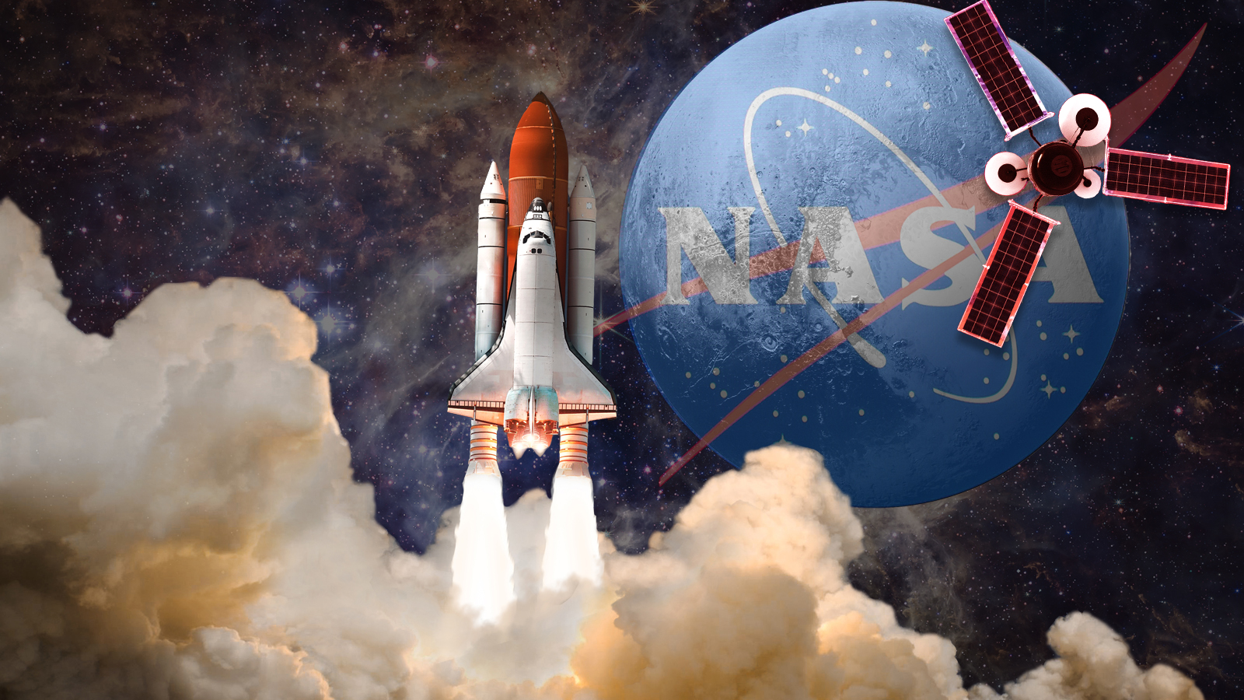
Hackathon NASA Apollo 23
Apollo 23
By edi,sebi,davide,chriss
By Davide, Edi, Cris and Sebi

Slide 2
Apollo 23
Apollo 23 is a new organization created by a small group of students from the British Romanian School
The team members are: Edi Traistaru, Chriss Staicu, Sebi Baleanu and Davide Giangaspero
.

Slide 3
How we came up with the idea ?
The idea came to us from the beginning of a contest organized by NASA, where we had to create a creative challenge of our own.
The rocket was created by Sebi and Davide, and Chriss and Edi took care of the technical part.
Initially we had no hope that the idea would work, but after a series of digital sketches we came to the conclusion that it was possible.

Slide 4
How do we want our project to go?
First of all we want the rocket to take off,and after taking off,when we leave the atmosphere,the engines that helped us to take off will fall,and then the other engines will be activate unitl we arive on Mars.On Mars the people will do some tests to see if we can plant resources.And at return we will reach the ground with the speare engies.

Slide 5
THANK YOU!

